Slide 1

A Graph Convolutional Neural Network (GCNN) Modelling for Hub-Gene identification in Alzheimer’s Disease Using Integrated Co-expression and Protein-Protein Interaction(PPI) analysis with Cross-Dataset Validation.
Presented by
FALGUNI YADAV (UG/02/BTCSE/2022/012)
RUCHI SINGH (UG/02/BTCSE/2022/054)
CHAITI BAIN (UG/02/BTCSE/2022/055)
Under the supervision of
Mr. Arup Mallick
Assistant Professor
Department of Computer Science and Engineering
Adamas University

Slide 2
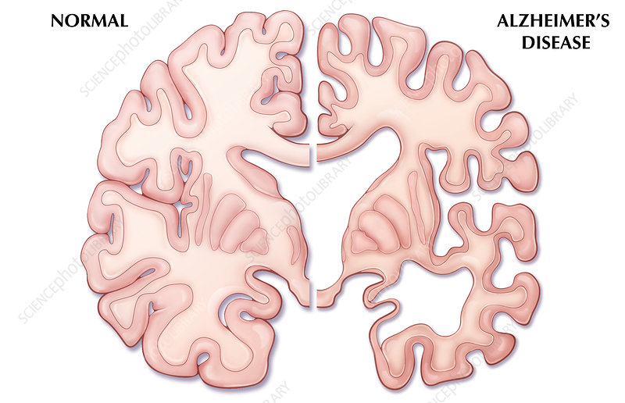
INTRODUCTION
Alzheimer’s disease is a progressive neurodegenerative disorder.
It leads to memory loss, cognitive decline, and impaired daily functioning.
The disease is associated with genetic and molecular changes.
Identifying important genes involved in the disease can improve understanding and treatment.
Computational approaches help analyze large biological datasets.

Slide 3
PROBLEM STATEMENT
Traditional gene analysis methods do not capture complex gene interactions.
Alzheimer’s disease involves multiple interacting genes and biological pathways.
There is a need for advanced computational models to analyze gene networks.
Identifying key hub genes can help in understanding disease mechanisms.

Slide 4
PROJECT OBJECTIVES
To analyze Alzheimer’s disease gene expression datasets from GEO database.
To identify Differentially Expressed Genes (DEGs).
To construct gene interaction networks using co-expression and protein–protein interaction data.
To apply Graph Convolutional Neural Network (GCNN) for network analysis.
To identify highly influential hub genes associated with Alzheimer’s disease.

Slide 5
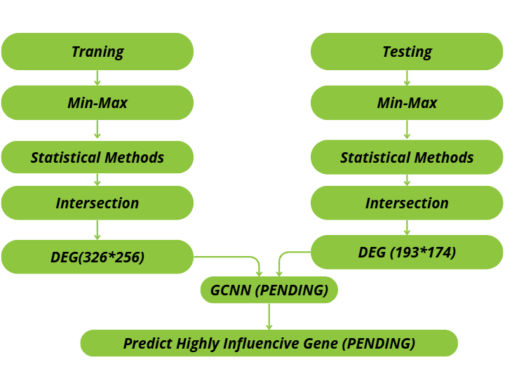
PROPOSED METHODOLOGY
Collect gene expression datasets from GEO database.
Perform data preprocessing and normalization.
Identify Differentially Expressed Genes (DEGs).
Build gene co-expression and protein–protein interaction networks.
Apply Graph Convolutional Neural Network (GCNN).
Predict highly influential hub genes.

Slide 6
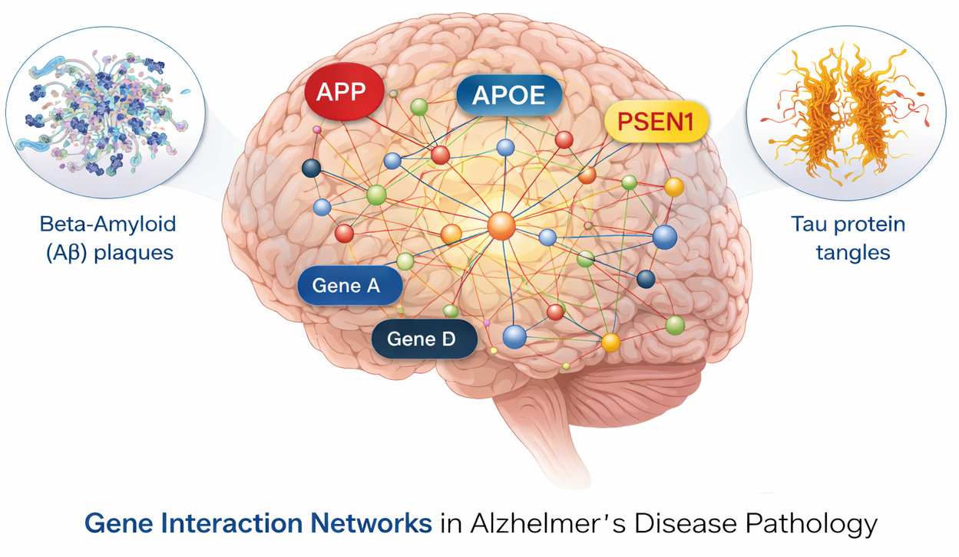
EXPECTED OUTCOMES
Identification of important hub genes in Alzheimer’s disease.
Better understanding of gene interaction networks.
Potential biomarkers for early diagnosis.
Possible targets for future therapeutic research.

Slide 7
thank you

